Slide 1
Final Presentation of Excel project
Neukölln
Feb 28, 2020
Anshal Gupta

Slide 2
Airbnb is an online marketplace that connects people who want to rent out their homes with people who are looking for accommodations in that locale. It currently covers more than 81,000 cities and 191 countries worldwide. The company's name comes from "air mattress B&B.” In Germany, no city is more popular than Berlin. That implies that Berlin is one of the hottest markets for Airbnb in Europe, with over 22,552 listings as of November 2018.
About Project
AIRBNB BERLIN,GERMANY

Slide 3
Problem statement
Average Price of rooms in different areas of berlin.
Average price by number of nights.
Most popular boroughs in berlin.
Most popular listings in borough.
Types of rooms available in different borough.
number of beds in each listings.
Price by minimum nights.
Source of data: Kaggle
Link-https://www.kaggle.com/brittabettendorf/berlin-airbnb-data
Created by murray cox-
http://insideairbnb.com/get-the-data.html

Slide 4
Basic Analysis on Problem Statement

Slide 5
Average price by room type

Slide 6
Average price in different borough

Slide 7
Available room types in different borough

Slide 8
Top 10 listings having most number counts

Slide 9
Top 10 listings by number of reviews

Slide 10
Top 5 borough with most number of listings

Slide 11
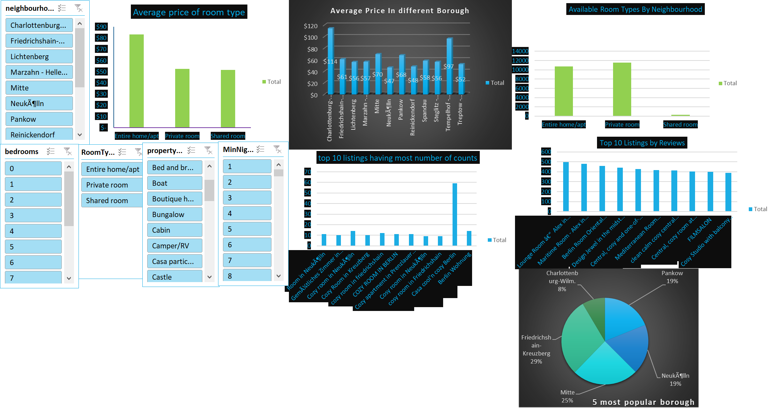
Final outcome (dashboard snapshot)

Slide 12
Conclusion
After the completion of project we are able to combine all the pivot tables to form a dashboard.
All the analysis can be easily now with a help dashboard slicers.
Different Visualization charts enriches the analysis

